Slide 1

Microbial Community Profiling Matt Settles, PhD University of California, Davis settles@ucdavis.edu bioinformatics.ucdavis.edu
Bioinformatics Core
Genome Center
UC Davis

Slide 2
Disclaimer
This talk/workshop is full of opinion, there are as many different way to perform analysis as there are Bioinformaticians.
My opinion is based on over a decade of experience and spending a considerable amount of time to understand the data and how it relates to the biological question.
Each experiment is unique, this workshop is a starting place and should be adapted to the specific characteristics of your experiment.

Slide 3
Outline
Data Science
Introduction to Sequencing
Experimental Design: community analysis
Workshop example data
The command line
dbcAmplicons: Generating Amplicons
dbcAmplicons: Python Applicatoin

Slide 4
Bioinformatics IS a Data Science
Section

Slide 5

The data deluge
Plucking the biology from the Noise

Slide 6
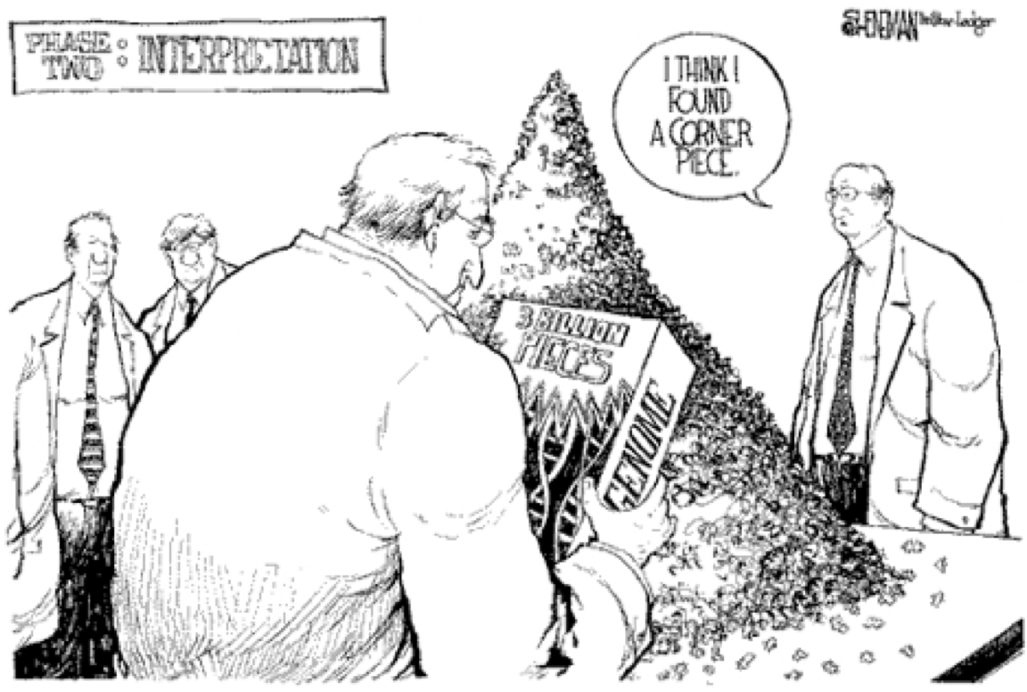
Reality
Its much more difficult than we may first think

Slide 7
The real cost of sequencing
The real cost of sequencing: higher than you think!
Sboner et al. Genome Biology 2011 12:125 doi:10.1186/gb-2011-12-8-125 (2011)

Slide 8
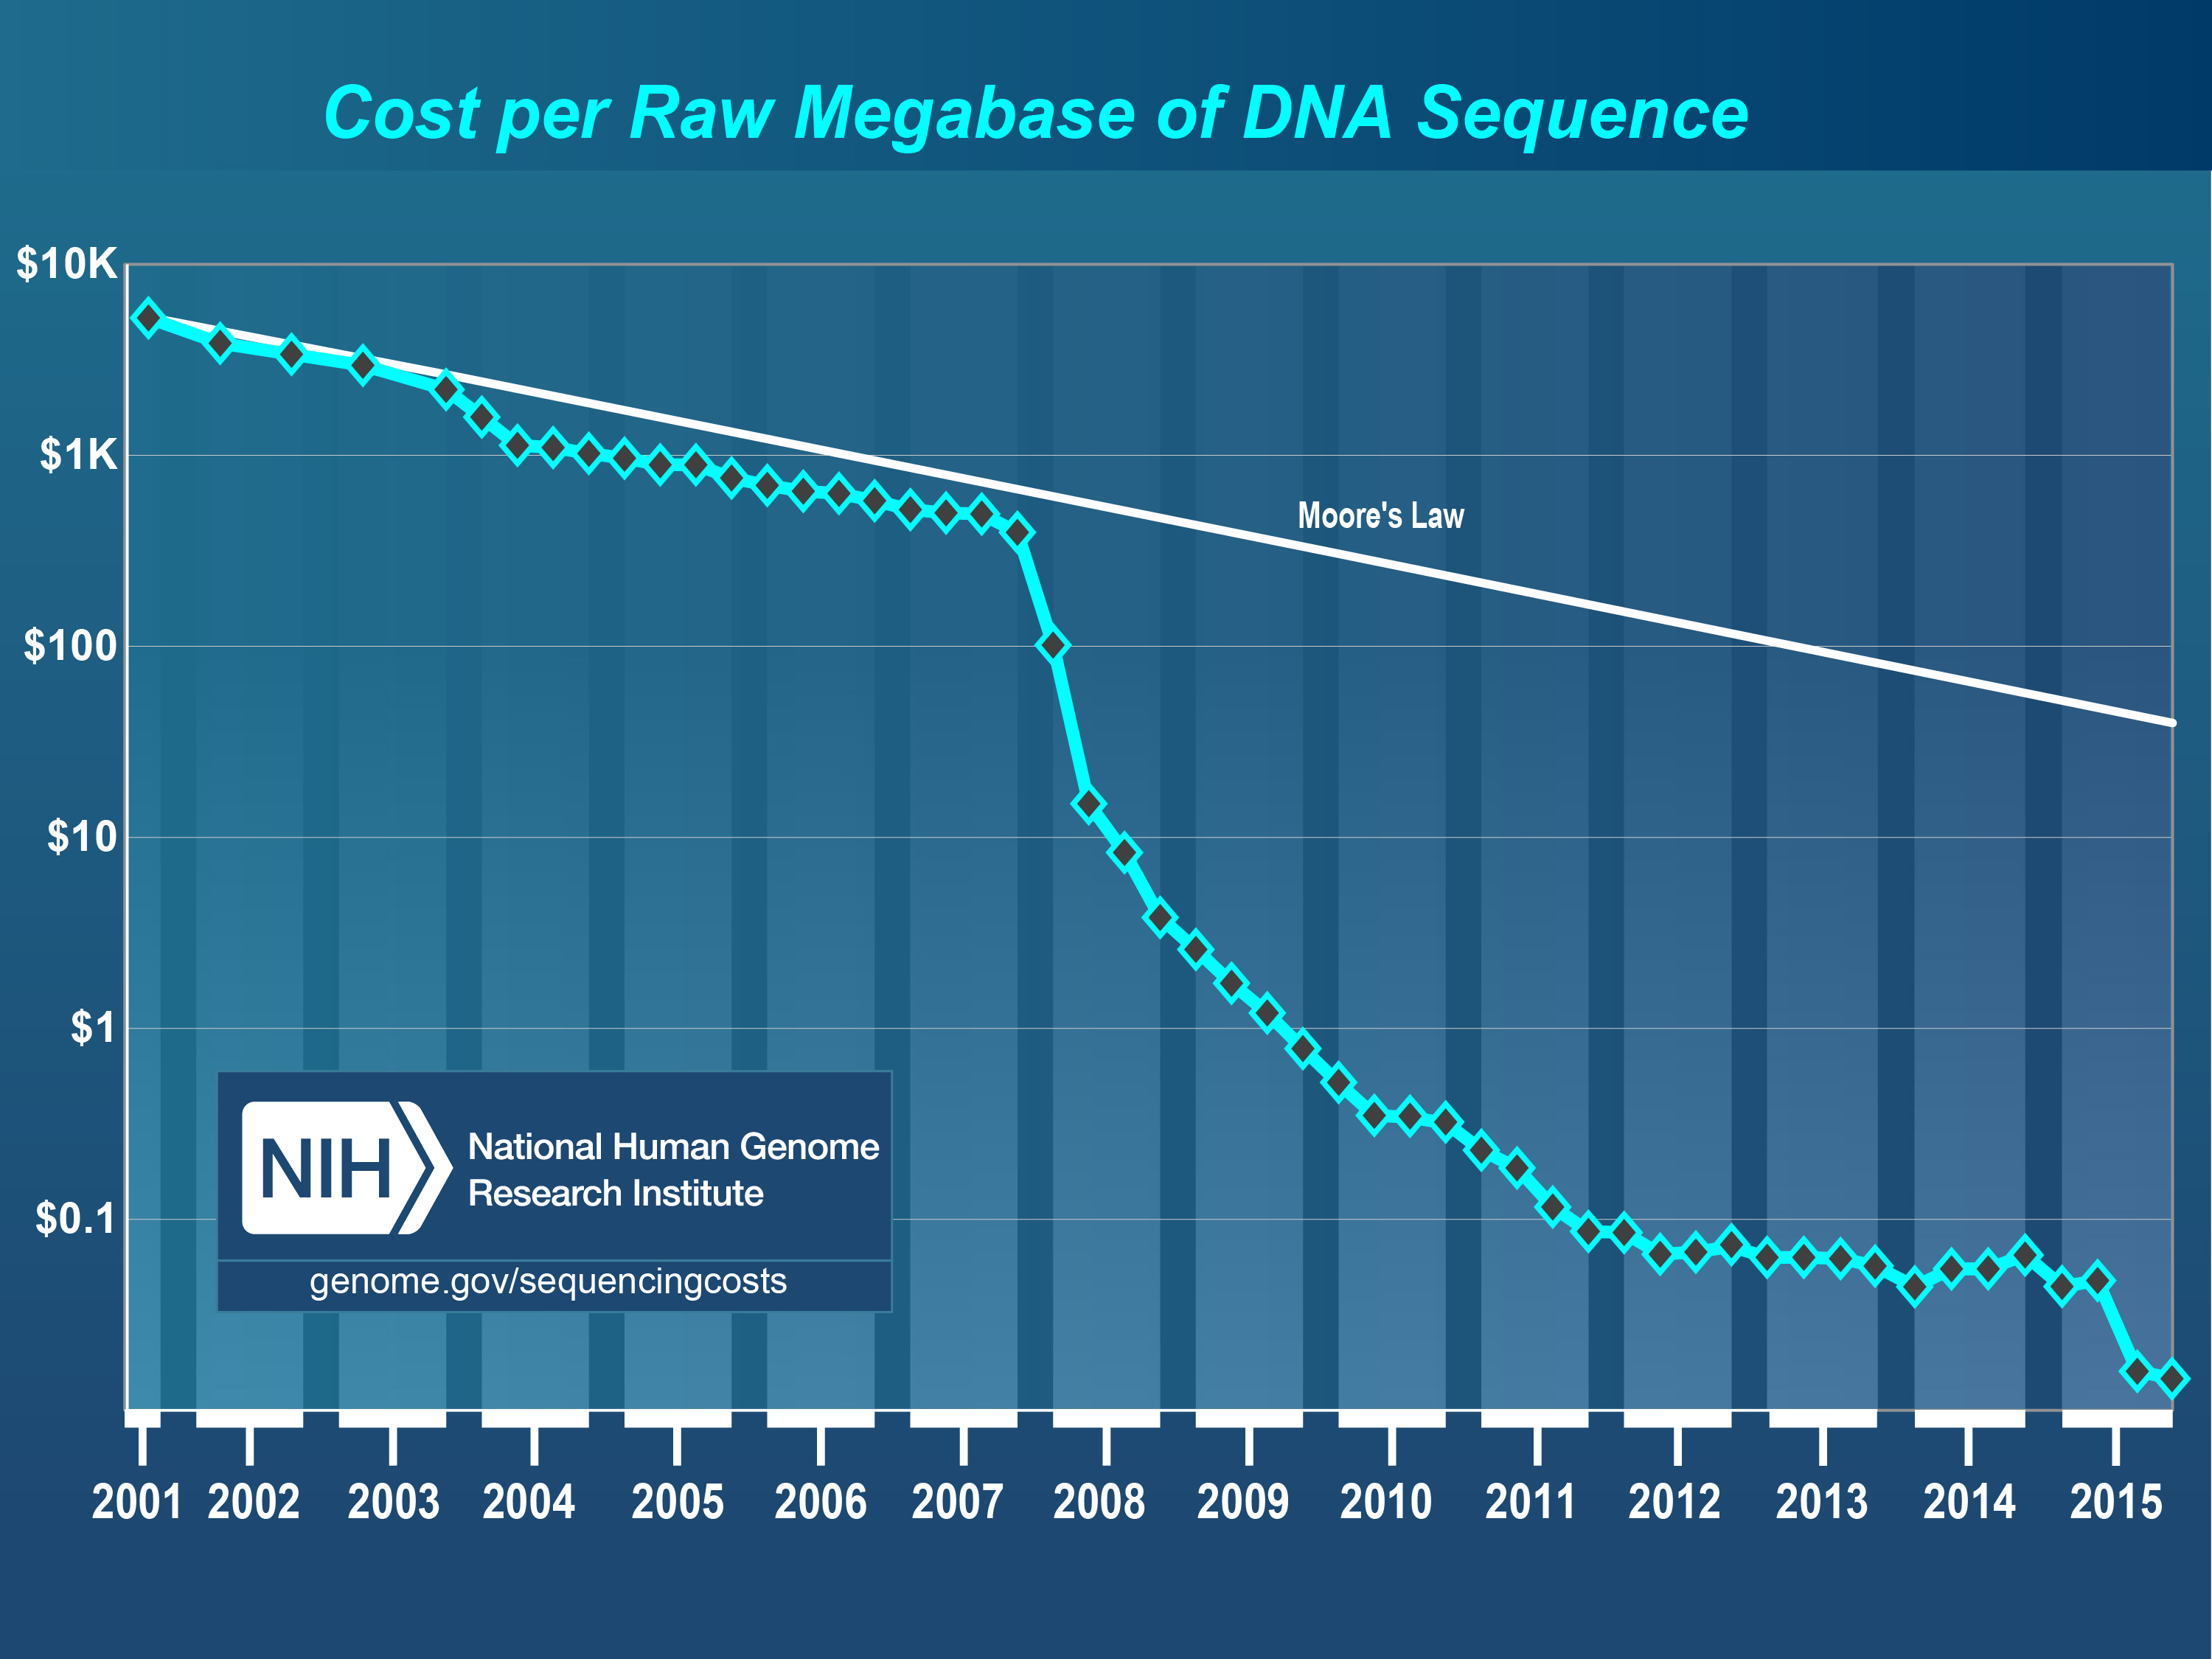
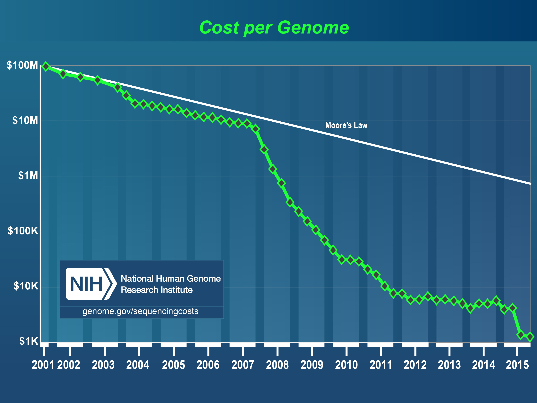
Sequencing Costs
GROWTH IN SEQUENCING
October – 2015
$0.014 per Megabase
$1,245 per Human Sized Genome (30x coverage)
Data Only!!
Does not include any analysis or bioinformatics

Slide 9


Bioinformatics is Data Science
Computational Biology
Biology
Math
Statistics
Computer
Science
Biostatistics
Bioinformatics
‘The data scientist role has been described as “part analyst, part artist.”’
Anjul Bhambhri, vice president of big data products at IBM
Notes:
Big data is an evolving term that describes any voluminous amount of structured, semi-structured and unstructured data that has the potential to be mined for information.
The Cloud is just a rebranding of

Slide 10
Data Science
Data science is the process of formulating a quantitative question that can be answered with data, collecting and cleaning the data, analyzing the data, and communicating the answer to the question to a relevant audience.
Five Fundamental Concepts of Data Science
statisticsviews.com November 11, 2013 by Kirk Borne
Notes:
Kirk Borne – George Mason University

Slide 11
Experiment Philosophy
Design
Experiment
Prepare Libraries
Analyze
Perform Experiment
Sample and Extract RNA/DNA
Sequence
Interpret

Slide 12
7 Stages to Data Science
Define the question of interest
Get the data
Clean the data
Explore the data
Fit statistical models
Communicate the results
Make your analysis reproducible

Slide 13
Stage 1: define the question
Define the question of interest
Begin with the end in mind!
what is the question
how are we to know we are successful
what are our expectations
dictates
the data that should be collected
the features being analyzed
which algorithms should be use

Slide 14

Stages 2-4: Collecting and Cleaning
Get the data
Clean the data
Explore the data
Know your data!
know what the source was
technical processing in producing data (bias, artifacts, etc.)
“Data Profiling”
Data are never perfect but love your data anyway!
the collection of massive data sets often leads to unusual , surprising, unexpected and even outrageous.

Slide 15
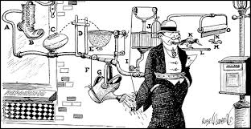
Stage 5: Analyzing the data
Fit statistical models
Over fitting is a sin against data science!
Model’s should not be over-complicated
If the data scientist has done their job correctly the statistical models don't need to be incredibly complicated to identify important relationships
In fact, if a complicated statistical model seems necessary, it often means that you don't have the right data to answer the question you really want to answer.

Slide 16

Stages 6-7: Communicating your results
Communicate the results
Make your analysis reproducible
Remember that this is ‘science’!
We are experimenting with data selections, processing, algorithms, ensembles of algorithms, measurements, models. At some point these must all be tested for validity and applicability to the problem you are trying to solve.

Slide 17
Bioinformatics done well
Data science done well looks easy – and that’s a big problem for data scientists
simplystatistics.org
March 3, 2015 by Jeff Leek

Slide 18


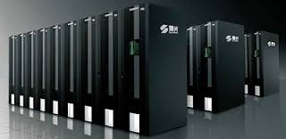
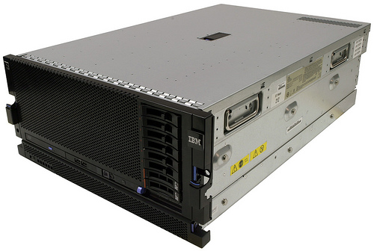

Substrate
Cloud
Computing
Cluster
Computing
BASTM
LINUX
Laptop & Desktop

Slide 19








Environment
“Command Line” and “Programming Languages”
Open
Source
VS
Bioinformatics Software Suite

Slide 20
Prerequisites
Access to a multi-core (24 cpu or greater), ‘high’ memory 64Gb or greater Linux server [Metagenomics].
Familiarity with the ’command line’.
Basic knowledge of how to install software
Basic knowledge of R and statistical programming
Basic knowledge of Statistics and model building

Slide 21
Bioinformatics
Know and Understand the experiment
“The Question of Interest”
Develop a deep familiarity and understanding of the techniques/tools/methods
Build a set of assumptions/expectations
Mix of technical and biological
Spend your time testing your assumptions/expectations
Don’t spend your time finding the “best” software
Don’t under-estimate the time Bioinformatics may take
Be prepared to accept ‘failed’ experiments

Slide 22
THE Bottom Line
The Bottom Line:
Spend the time (and money) planning and producing good quality, accurate and sufficient data for your experiment.
Get to know to your data, develop and test expectations
Result, you’ll spend much less time (and less money) extracting biological significance and results during analysis.

Slide 23
Introduction to sequencing
Section

Slide 24
History
It would take a few more decades after the discovery of the double helix in 1953 before we could readily analyze fragments of DNA.
RNA sequencing actually preceded DNA sequencing when Walter Friers from the University of Ghent published the first complete gene and genome of Bacteriophage MS2 in 1972 and 1976 respectively.
Location specific primer extension: Raw Wu (1970), using DNA polymerase catalysis and specific nucleotide labeling.
Chain-terminating inhibitors: Frederick Sanger (1977), aided in speeding up the process

Slide 25
history
Leroy E. Hood’s laboratory at the California Institute of Technology announced the first semi-automated DNA sequencing machine in 1986.
Applied Biosystems’ produced the first fully automated sequencing machine, the ABI 370, in 1987, followed by the ABI Prism 373, (1990), ABI Prism 377 (1995), ABI Prism 310 (also 1995) represented the first capillary sequencer, ABI Prism 3700 (1999, the workhorse of the human genome project), ABI 3730xl DNA analyzer (2002) @ 2M bases per day.

Slide 26
History
Primer Walking
Design a primer that matches the sequence neighboring the unknown sequence
Sequence the short DNA strand using the Sanger method
The new sequenced portion is used to design a new primer and repeat
de novo sequencing or “shotgun sequencing”
High-molecular weight DNA is sheared into random fragments
‘Shorter' fragments are cloned into a vectors
clones are sequenced from both ends, creating two ”reads”
original sequence is reconstitutes by ”assembling” the reads

Slide 27
Roche 454
The first massively parallel method (aka “next generation sequencing”) to become commercially available was developed by 454 Life Sciences in 2005 (acquired by Roche in 2007) and is based on the pyrosequencing technique. Similar to the Sanger method, sequencing is carried out using primed synthesis by DNA polymerase. However in the 454 pyrosequencing method, the DNA fragments are presented with each of the four dNTPs sequentially and without a dye-terminator, as is done with Sanger sequencing, allowing for multiple incorporation in the same flow. The amount of the incorporation is monitored by luminometric detection of the pyrophosphate released (hence the name ”pyrosequencing”).
700 Mb/day

Slide 28
Illumina (SOLEXA)
The second “next generation” sequencing technology to be released (in 2006) was Illumina Solexa sequencing. A key difference between Roche 454 and Illumina sequencing was the use of chain-terminating nucleotides. The fluorescent label on the terminating base can be removed to leave an unblocked 3’ terminus, mating the chain termination a reversible process. The method thus sequences one base at a time, rather than 0 or more bases as does Roche 454.
> 400Gb/day

Slide 29
Life Technologies
Ion Torrent PGM, first available in 2011, generates up to 400bp reads (reported) and up to 2Gb (5.5m reads) per run. Cheap fast runs. Ion Proton system can generate up to 10Gb per run. Generates flowgrams and SFF files similar to Roche 454 data as well as the standard fastq files. Ion Torrent is also considered a second generation sequencer.
~ 64Gb/day

Slide 30
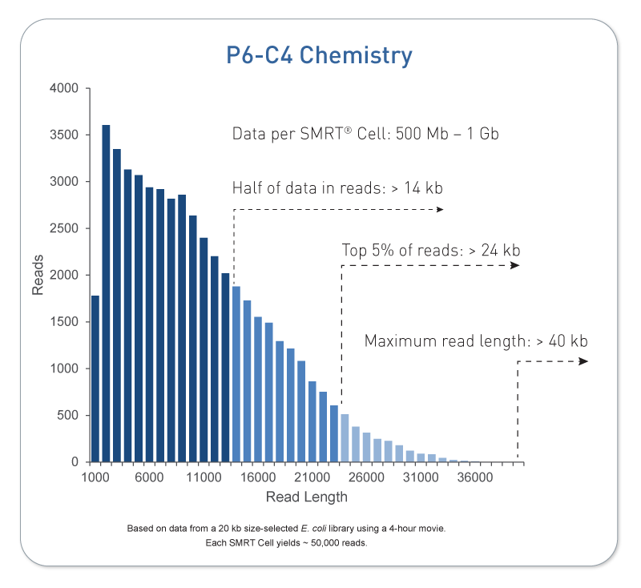
Pacific Biosystems
Pacific Biosystems is so far the most successful third generation DNA sequencing system. Key differences are that its a single molecule, real time (SMRT) technology and capable of producing sequences of multi-kilobases.
~ 2Gb/day (20Gb/day)
Third generation sequencers are single molecule sequencers.

Slide 31
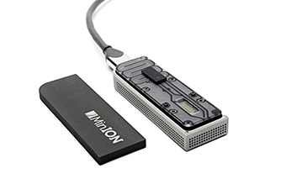
Oxford nanopore
Another 3rd generation sequencer, founded in 2005 and recently (May 2015) produced a commercial product, the MinION. The sequencer uses nanopore technology developed in the 90’s to sequence single molecules.
> 1Gb per flowcell
FYI: 4th generation sequencing is being described as “In-situ sequencing”, for applications such as ”spatial transcriptomics”

Slide 32
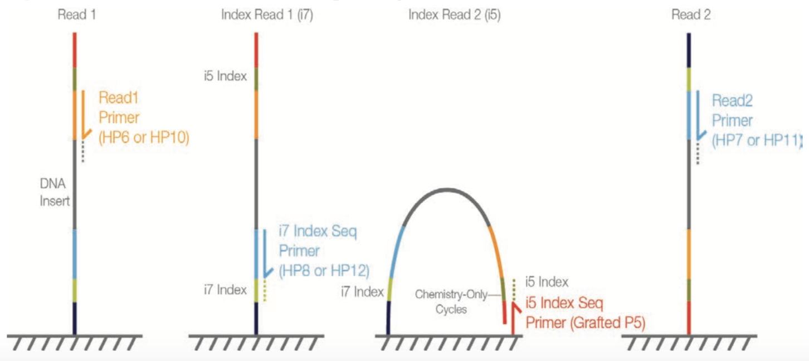
Illumina sequencing
Read 2 (50-300bp)
Illumina SBS
P5 BC2
Target Region
BC1 P7
BC1 (8bp)
Read 1 (50 - 300bp)
BC2 (8bp)
Insert size
Fragment length

Slide 33
Genomic Reduction
3GB
1X
Whole Genome
RADseq
GBSseq
RNAseq
Capture Techniques
Depth of Coverage
Genomic reduction allows for greater multiplexing of samples.
You can fine tune your depth of coverage needs and sample size
with the reduction technique
Fluidigm Access Array Amplicons
1KB
100000X
Few or Single Amplicons

Slide 34
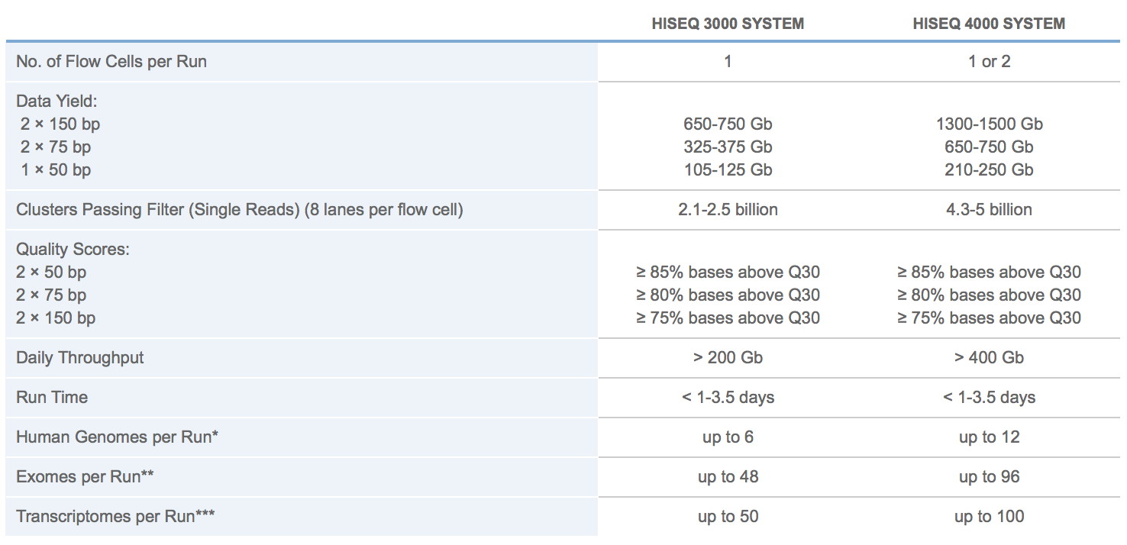
Illumina HISEQ sequencing
2500
http://www.illumina.com/systems/hiseq-3000-4000/specifications.html
MiSeq

Slide 35
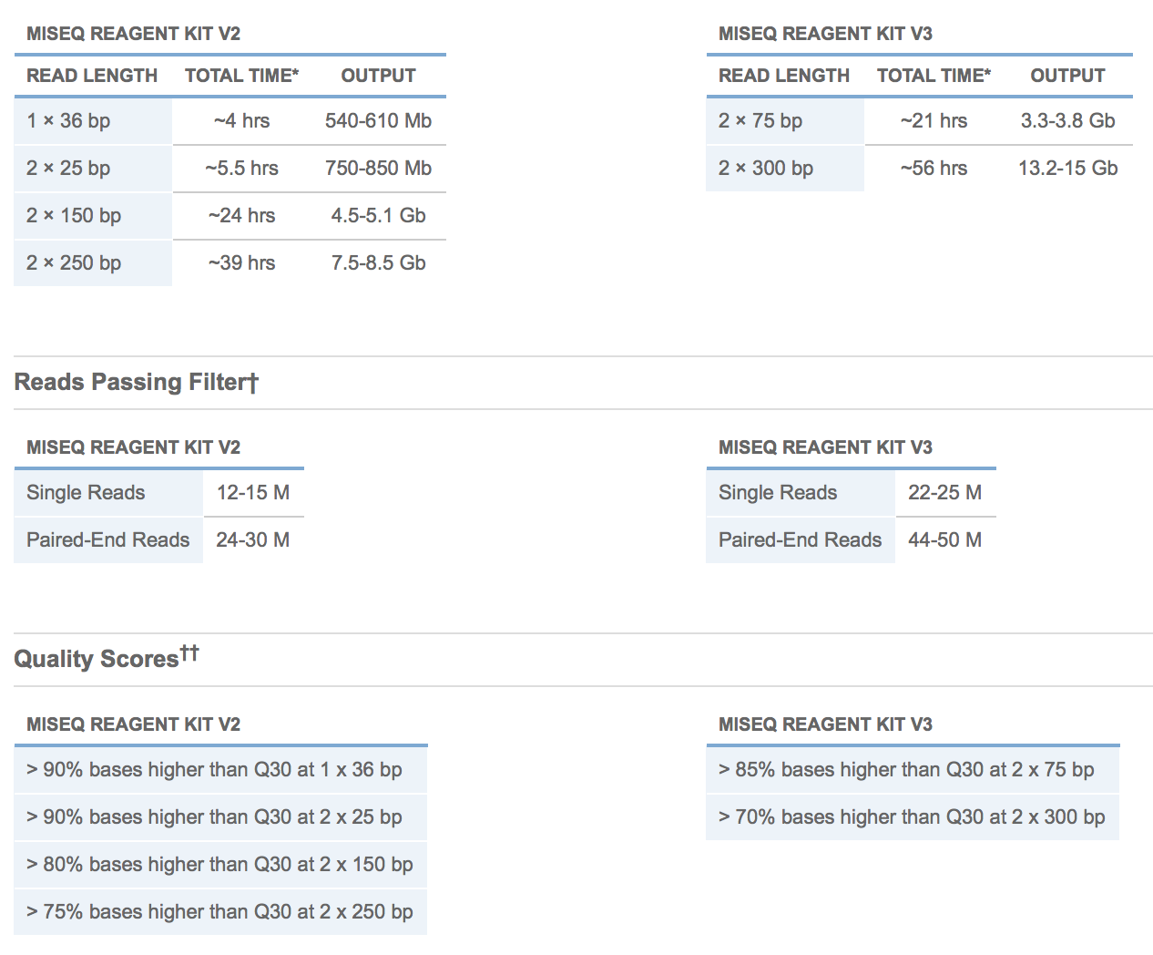
Illumina MISEQ SEQUENCING

Slide 36
HomeWork
Perform
Visit the Illumina website
How many sequencing machines does Illumina Have?
What are the differences between the HiSeq 2500 series and HiSeq 3000/4000 series machines?
What are differences in read length options between the MiSeq and HiSeq?
What are the differences between the HiSeq’s High Output Run Mode and the Rapid Run Mode
How many reads (and bp) do you get on one lane of a HiSeq 2500 in High Output Run Mode for 1x50 and 2x100, compare those to what you get on the HiSeq 3000
How many reads (and bp) do you get from one run of a MiSeq 2x300.
Getting to know Illumina

Slide 37
Experimental Design: Community profiling
Section

Slide 38
Experimental design
In high throughput biological work (Microarrays, Sequencing, HT Genotyping, etc.), what may seem like small technical artifacts introduced during sample extraction/preparation can lead to large changes, or technical bias, in the data.
Not to say this doesn’t occur with smaller scale analysis such as Sanger sequencing or qRT-PCR, but they do become more apparent and may cause significant issues during analysis.

Slide 39
General rules for preparing samples
Prepare more samples then you are going to need, i.e. expect some will be of poor quality, or outright fail
Preparation stages should occur across all samples at the same time (or as close as possible) and by the same person
Spend time practicing a new technique to produce the highest quality product you can, reliably
Quality should be established using Fragment analysis traces (pseudo-gel images, FOR RNA RIN > 7.0)
DNA/RNA should not be degraded
260/280 ratios for RNA should be approximately 2.0 and 260/230 should be between 2.0 and 2.2. Values over 1.8 are acceptable
Quantity should be determined with a Fluorometer, such as a Qubit.
BE CONSISTENT ACROSS ALL SAMPLES!!!

Slide 40
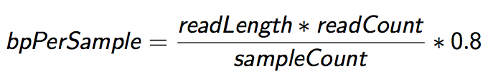
Sequencing Depth
The first and most basic question is how many base pairs of sequence data will I get Factors to consider are:
1. Number of reads being sequenced
2. Read length (if paired consider then as individuals)
3. Number of samples being sequenced
4. Expected percentage of usable data
The number of reads and read length data are best obtained from the manufacturer’s website (search for specifications) and always use the lower end of the estimate.

Slide 41
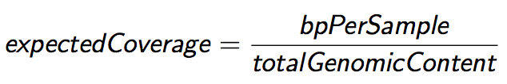
Sequencing Coverage
Once you have the number of base pairs per sample you can then determine expected coverage Factors to consider are:
1. Length of the genome (in bp)
2. Any extra-genomic sequence, or contamination
Coverage is determined differently for ”Counting” based experiments (RNAseq, amplicons) where an expected number of reads per sample is typically more suitable.

Slide 42
MG Sequencing Designs
Taxonomic Identification
Amplicon based (e.g. 16s variable regions)
Shotgun Metagenomics
Functional Characterization
Shotgun Metagenomics
Shotgun Metatranscriptomics (active)
Genome Assembly, Function and Variation
Shotgun Metagenomics
Shotgun Metatranscriptomics

Slide 43
Proposal Stage
Considerations (when a literature search turns up nothing)
Proportion that is host (non-microbial genomic content)
Proportion that is microbial (genomic content of interest)
Number of species
Genome size of each species
Relative abundance of each species
The back of the envelope calculation
*
Coverage
Average_Genome_Size
#Reads
=
*
*
*
0.8
Read_Len
Dillution_factor
1-Host_prop

Slide 44
Rarefaction curves
Plot rarefactions curves of Amplicons, or reconstituted 16S sequence to determine if saturation is achieved
Miller CS, Baker BJ, Thomas BC, Singer SW, Banfield JF (2011) EMIRGE: reconstruction of full-length ribosomal genes from microbial community short read sequencing data. Genome biology 12: R44 doi:10.1186/gb-2011-12-5-r44.

Slide 45
Metagenomics assembly
To determine if you’ve sequenced ‘enough’ to re-assemble ‘most’ of the community member’s genetic content, look to what is left over - proportionally

Slide 46
Take HOmes
Experience and/or literature searches (other peoples experiences) will provide the best justification for estimates on needed depth.
Don’t forget about ‘contamination’ can often be a large source of reads.
‘Longer’ reads are better than short reads, especially for assembly.
Libraries can be sequenced again, so do a pilot, estimate ‘contamination’, compute rarefaction/16s coverage then sequence more accordingly.

Slide 47
Cost Estimation
DNA/RNA extraction QA/QC (Bioanalyzer/Gels)
Metatranscriptomes: Enrichment of RNA of interest and RNA library preparation
Library QA/QC (Bioanalyzer and Qubit)
Pooling ($10/library)
Metagenomes: DNA library preparation
Library QA/QC (Bioanalyzer and Qubit)
Pooling ($10/library)
Community Profiling: PCR reactions
Library QA/QC (Bioanalyzer and Qubit/microplate reader)
Pooling
Sequencing (Number of Lanes / runs)
Bioinformatics (General rule is to estimate the same amount as data generation, i.e. double your budget)
http://dnatech.genomecenter.ucdavis.edu/prices/

Slide 48
HomeWork
Perform
Search the web for 16s reads per sample recommendations.
Cost estimate a metagenomics (DNA) project analysis on 8 samples, 2x100 on a HiSeq 3000 using the number of reads target determined in the last homework
COVERAGE

Slide 49
Shotgun Read processing
Section

Slide 50
Preprocess reads
We have found that aggressively ”cleaning” and processing reads can make a large difference to speed and quality of assembly and mapping results. Cleaning your reads means, removing reads/bases
that are:
not of primary interest (contamination)
originate from PCR duplication
artificially added onto sequence of primary interest (vectors, adapters, primers)
low quality bases
other unwanted sequence (polyA tails in RNA-seq data)
join short overlapping paired-end reads

Slide 51
Read Preprocessing strategies
Identity and remove contaminant and vector reads
Reads which appear to fully come from extraneous sequence should be removed.
Quality trim/cut
“end” trim a read until the average quality > Q (Lucy)
remove any read with average quality < Q
eliminate singletons/duplicates
If you have excess depth of coverage, and particularly if you have at least x-fold coverage where x is the read length, then eliminating singletons is a nice way of dramatically reducing the number of error-prone reads.
Read which appear the same (particularly paired-end) are often more likely PCR duplicates and therefor redundant reads.
eliminate all reads (pairs) containing an “N” character
If you can afford the loss of coverage, you might throw away all reads containing Ns.
Identity and trim off adapter and barcodes if present
Believe it or not, the software provided by Illumina, either does not look for, or does a mediocre job of, identifying adapters and removing them.

Slide 52
Read preprocessing Pipeline
The pipeline we’ve developed (expHTS) for read preprocessing employs the following steps for each read:
Contaminant screening (phiX minimum) → PCR duplicate detection/removal → 5’ and 3’ end quality trimming→ Join (when possible) and remove adapters from paired end reads → Final cleanup, remove too short sequence, second polyA/T removal. Finally generate statistics for each sample.
This pipeline is realized using the following applications
screen.py (part of expHTS), extract_unmapped_reads.py (part of expHTS), Super Deduper, Sickle, Flash, cleanupWrapper.py (part of expHTS)
This pipeline is also under active development:
https://github.com/msettles/expHTS
Processes multiple samples within a experiment, assumes a structure by default.

Slide 53
Preprocessing
screen.py and extract_unmapped_reads.py
Remove contaminants (at least PhiX), uses bowtie2 then extracts all reads (pairs) that are marked as unmapped.
Super-Deduper
Remove PCR duplicates (we use bases 10-35 of each paired read)
Sickle
Trim sequences (5’ and 3’) by quality score (I like Q20)
FLASH2
Join and extend, overlapping paired end reads
If reads completely overlap they will contain adapter, remove adapters
Identify and remove any adapter dimers present
cleanupWrapper.py
Remove any reads that are less then the minimum length parameter
Run a polyA/T screen (if RNA)
Produce run statistics

Slide 54
Files and Directory Structure
I use a strict directory structure to show the relationship between results and input, expHTS assumes this directory structure though it can be changed.
PARENT folder, name of the experiment
00-RawData
SEQUENCE_ID_1
Fastq Files
SEQUENCE_ID_2
Fastq Files
02-Cleaned
SAMPLE_ID_1
Fastq Files
SAMPLE_ID_2
Fastq Files
Preprocessing_Summary.log

Slide 55
Metadata File
Variables that describe each sample, including those that will be used to compare samples to each other (experimental factors). Also good to include all technical factors that may influence experimental results (ex. Day of RNA isolation) in order to test for effect later.
samples.txt – is a plain text tab delimited metadata file that will be used within the workshop to run expHTS and the R differential expression analysis. Rows are samples, columns are metadata
Two REQUIRED columns, add more columns as you need
“SEQUENCE_ID” – folder name containing the sequences
“SAMPLE_ID” – Name in which to assign the sample

Slide 56
QA/QC
Beyond generating better data for downstream analysis, cleaning statistics also give you an idea as to the quality of the sample, library generation, and sequencing technique used to generate the data.
This can help inform you of what you might do in the later processing steps.
I’ve found it best to perform QA/QC on both the sequencing run as a whole (poor samples can affect other samples) and on the samples themselves as they compare to other samples (REMEMBER, BE CONSISTANT).
Reports such as Basespace for Illumina, are great ways to evaluate the runs as a whole.
PCA/MDS plots of the preprocessing summary are a great way to look for technical bias across your experiment, expect randomness

Slide 57
METAGENOMICS Software
Remember this is “Data Science”, focus on the questions you wish to answer, the path to answering those questions and not on what is the ‘best’ software to use.
Software is rarely generated for the ’generic’ situation
Often untied to type of sequencing data, though often dependant
Often one and done, look for software that is currently being supported.
Work in a comparative framework, consistency of results across samples indicates comparability, biases are at least consistent and/or unassociated with the project factors.

Slide 58
Taxonomic Assignment
KRAKEN
A taxonomic classifier using k-mers, current db contains > 75Gb of microbial genome data (unique kmers).
Requires a large server, 128Gb to 256Gb of memory
Assigns each read to its lowest common ancestor in the tree in a taxonomic tree based on the set of kmers in a read
Accepts ‘single’ read fasta format (flags for pairs and fastq)
Output is ‘unusable’, meant for additional processing
Kraken-translate to output taxonomic assignment for every read, output can then be used to build abundance tables
Kraken-filter will move a read up the tree based on confidence of mapping (loosely based on proportion of kmers)
Can build your own database
Kraken-report and kraken-mpa-report for abundance table construction
MetaPhlAn
Classifies by using a set of marker genes – measures species abundances

Slide 59
Assembly
Many assemblers to choose from and more each day
Recent tutorial using cloud computing
http://www.ncbi.nlm.nih.gov/pmc/articles/PMC4496567/
Most metagenomics assemblers use kmers
Either normalize reads by kmers (remove what appears to be redundant information)
Or first bin by kmers (each bin is assumed to be a unique species), then assemble each bin (first normalizing by kmers).
Map reads back to assembly to estimate coverage/count
BUT then you have to do some with ambiguous contigs
Identify ORFs, marker genes, etc. to characterize gene/taxon content
IT IS all about the databases!!

Slide 60
MG-RAST
The MG-RAST system provides answers to the following scientific questions:
Who is out there? Identifying the composition of a microbial community either by using amplicon data for single genes or by deriving community composition from shotgun metagenomic data using sequence similarities.
What are they doing? Using shotgun data (or metatranscriptomic data) to derive the functional complement of a microbial community using similarity searches against a number of databases.
Who is doing what? Based on sequence similarity searches, identifying the organisms encoding specific functions.
Finally compare samples to each other

Slide 61
MG-RAST
Can upload
16s amplicons
Metagenomes/Metatranscriptomes
Assembled contigs
Raw reads
Use their resources for analysis, don’t have to have your own computational resources
More of a black box, but can download many of output data options
Subjected to their philosophy for analysis of metagenomic/transcriptomic data
A downloadable alternative to MG-RAST is MEGAN5

Slide 62
HOMEWORK 8
Perform
Launch read preprocessing via
expHTS preprocess
When complete perform QA/QC
Running preprocessing

Slide 63
Workshop dataset
Section

Slide 64
Slashpile
Slash Pile – Accumulated debris from cutting brush or trimming trees
Measured, bacteria and fungal communities using 5 amplicons
16sV1V3
16sV4V5
ITS1
ITS2
LSU
3 – slashpiles
2 depths
Distance from slashpile

Slide 65
HomeWork
Perform
Briefly scan the metadata files on the github page
Upload the fastq reads files to AWS, then extract them
https://drive.google.com/open?id=0B_3lTFvg_WhxMVQwUEtZaV9rQzA
Workshop Data

Slide 66
The Command line
SECTION

Slide 67
The command line
The command line is powerful and the preferred way to run bioinformatics tools
BASICS:
Prompt msettles@MacBook-Pro:~$
~ is your home director
... $ command [parameters] [files] ENTER
parameters begin with a - short parameter or -- long parameter
Help ... $ man command
… $ command –h
… $ command –help
Tab complete!!

Slide 68
The command line
Command input/output:
file/folder on the command line, either as a positional argument or a parameter, or defaults
stdin aka ‘standard in’, input pipe
stdout aka ‘standard out’, output pipe
stderr aka ‘standard error’, pipe for error messages
Special characters:
| vertical bar is the pipe, it pipes the stdout of one command
to the stdin of another cmd
< > 2> feeds stdin, stdout, stderr to the command
>> append
& at the end of a command will run the command in the background
. Current directory
.. Up one folder
/ folder delimiter
* wild character, match anything
When naming files/folders avoid special characters and spaces ( use . and _ )!!

Slide 69
The command line
Basics Commands:
pwd print the working directory (current dir)
ls [file/dir] list the current contents of the directory
ls –lah [file/dir] long list, human readable, show hidden of the directory
cd to change directory
cp f1 f2 copy file f1 to file f2
mv from to mv directory (also way to rename)
mkdir dir make directory
rm file remove file
rmdir dir remove an empty directory
rm –r dir recursively remove a non-empty directory
nano file edit a document
cat f1 [f2] print to stdout file f1 then if provided file f2 (concatenate)
less file view file, one page at a time
head file view the first 10 lines of a file
tail file view the last 10 lines of a file

Slide 70
CHEaT SHEETS
Cheat Sheets are available on the github page

Slide 71
HomeWork
Perform
Look at your home directory, what files are already there, what files are hidden
Create a new folder
Move into that folder and create a file (write anything)
Show that file, using less and cat
Go back to your home directory
Create a second folder
Copy the file from the first directory to the new directory
Move to your home directory
Remove both folders
Learn to use the command ’wc’ with ‘man wc’
Play with the new commands
Playing with the command line

Slide 72
gIT
Git is an open source program for tacking changes in text files. Its was written by the author of the Linux operating system, Linus Torvalds. Use git for:
Tracking software changes
Tracking notes changes
Tracking document changes
Github is a web-based Git repository hosting service, free to use for open repositories
This workshop is available via git and github
https://github.com/msettles/Workshop_Community-Profiling

Slide 73
GIT
git clone [repo] –to clone a copy of a repository from the remote server (github) onto your workstation. With your clone you can edit the documents as you please
git status – displays the differences between your repositories and the current working head (changes you’ve made).
git pull – when you fetch in changes to the repository and merging them in. for example if I edited the workshop repository, you can then pull in those changes to your workstation
git checkout – to checkout different branches

Slide 74
HOMeWORK
Perform
Install system software
sudo apt-get install bowtie2
sudo apt-get install openjdk-7-jdk
sudo apt-get install ant
Using git clone, install from repositories on github
FLASH2
Using Make, link onto the Path
RDPtools
Using Make
dbcAmplicons
python setup.py install
Install expHTS using git and python

Slide 75
dbcAmplicons
Section

Slide 76
Microbial community analysis
Goal: A culture independent method for profiling the diversity of a community.
High-throughput sequencing technologies (such as Illumina) can generate millions of amplicons, across thousands of samples in a single run, and are today our best approach to deeply assess the environmental or clinical diversity of complex microbial assemblages of archaea, bacteria, and eukaryotes.
Using sequence variation within a common gene (e.g. 16s) to assign and count community members rather than counting individual cells. Assume each sequence variant is one community member.

Slide 77
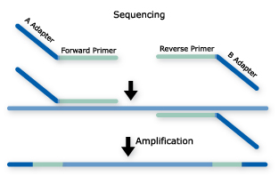
Amplicons: Common Approach
Single PCR
Long primer sequences (~75bp) that contain barcodes and sequencing adapters
Single or dual barcodes
(dual barcode often within read 2)
Common approach

Slide 78
dbcAmplicons
Originally conceived in late 2012 to lower per sample costs on relatively short targeted (PCR) regions
16S, ITS, LSU, 18S, etc. Community profiling
Extraction of mitochondria, virae, chloroplast regions, plasmids by PCR
Genotyping of samples for phylogenomics, genome to phenotype interactions
Uses the Illumina platform, capably of pooling thousands, or even tens of thousands of barcoded samples/targets per sequencing run.
Core Facility friendly, facilitates interactions between and across individual labs, standardizing workflows.

Slide 79
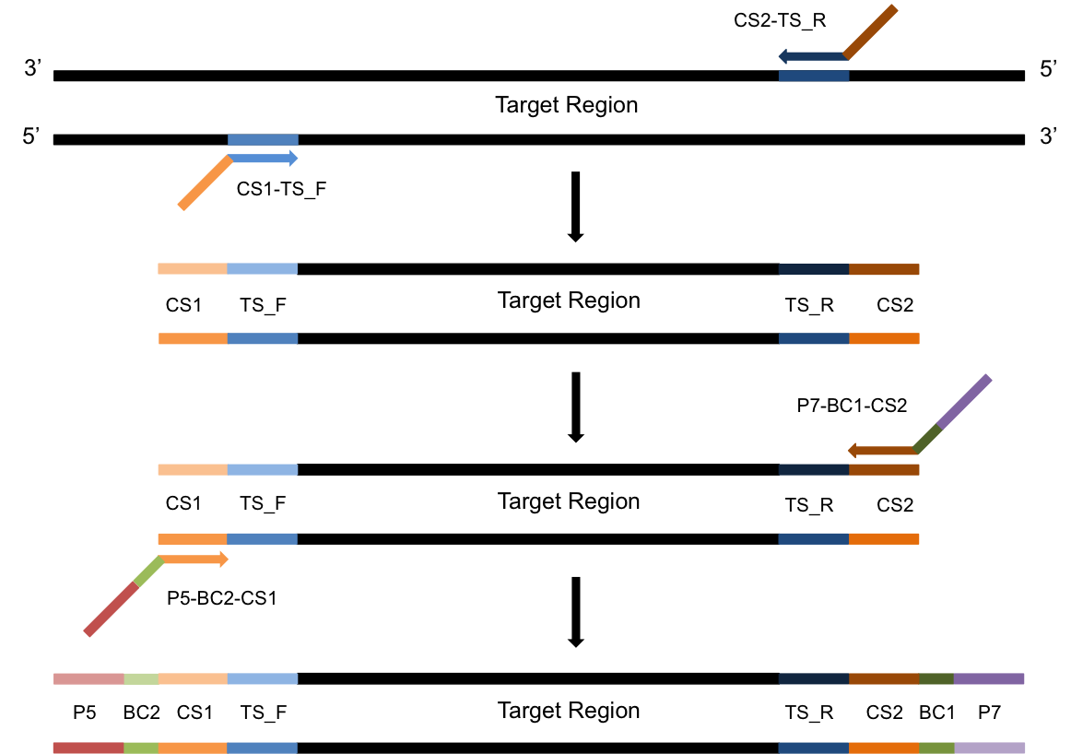
Amplicons: Alternative Approach
PCR-1
Template with overhang
PCR-2
Add barcodes and adapters
Barcodes and adapters are added in the second round of PCR

Slide 80
Multiplex Samples
Dual barcoding allows for massively multiplexing of samples using only a relatively few primers
Pairing of BC1 and BC2 uniquely identifies sample
^{GTATCGTC}
^{TGCTCGTA}
^{GTCGTCGT}
^{GTGCGTGT}
^{GCGTCGTG}
^{GTCGTGTA}
^{GATGTAGC}
^{GAGTGATC}
^{CGCTATCA}
^{CGCTGTAG}
8bp [Error-Correcting]
Barcodes
5 Pairs of Barcodes allows for multiplexing of 25 samples.
32 Pairs can multiplex 1024 samples in the same sequencing reaction

Slide 81
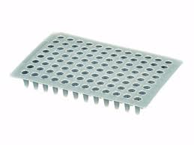
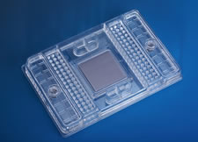
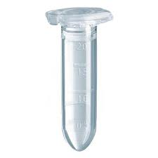
Multiplex Amplicon Targets
Fluidigm Access Array System
PCR-1 product
PCR-2 product
48 samples X 48 amplicons
2304 Two-step PCR reactions
Pool many samples

Slide 82
dbcAmplicons
Two-step PCR
highly multiplexed and modular amplicon design
DNA
Performed in Researcher’s Lab
Target Specific
Primer Design
Primer Validation
Dual-barcoded
Two-step
PCR
Pooling
And
Quantification
Python dbcAmplicons application
Performed in Core Facility
Downstream
Analysis
Preprocess:
Demuliplex by barcodes and primer sequences
Illumina Sequencing
Four Read Setup

Slide 83
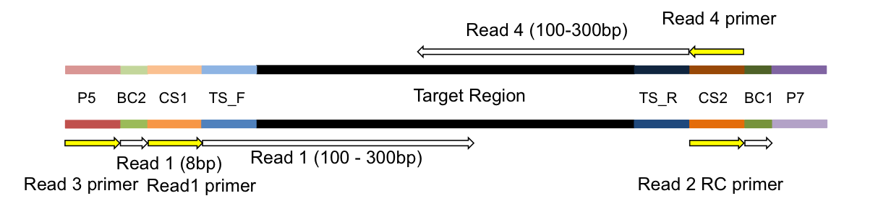
Sequencing
Illumina four read sequencing run
Read | Sequencing Primer
Read1 primer | CS1 - 5’ ACACTGACGACATGGTTCTACA
Read2 primer | CS2 - 5’ TACGGTAGCAGAGACTTGGTCT
BC1 primer | CS2rc - 5’ AGACCAAGTCTCTGCTACCGTA
BC2 primer | Uses the P5 amplification primer

Slide 84
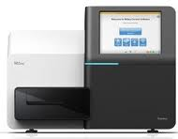
Bioinformatics
Illumina bcl2fastq 1.8.4
Four
Fastq files
Barcode Table
“Preprocess”
Demultiplex barcode and
primer sequences
dbcAmplicons
Python Application
Primer Table
Sample Sheet
Barcode | Match determined by edit-distance, allowing for 1 mismatch per barcode (by default)
Primers | Match determined by Levenshtein Distance allowing for 4 mismatches (by default) with the final 4 (by default) bases required to be perfect matches
Overlap paired reads
(wrapper around custom Flash2)
Downstream Analysis
https://github.com/msettles/dbcAmplicons

Slide 85
Downstream Analysis
Population Community Profiling ( i.e. microbial, bacterial, fungal, etc. )
dbcAmplicons Python Application
Screen | Using Bowtie2, screen targets against a reference fasta file, separating reads by those that produce matches and those that do not match sequences in the reference database.
Classify | Wrapper around the MSU Ribosomal Database Project (RDP) Classifier for Bacterial and Archaeal 16S rRNA sequences, Fungal 28S rRNA, fungal ITS regions
Abundance | Reduce RDP classifier results to abundance tables (or biom file format), rows are taxa and columns are samples ready for additional community analysis.
Targeted Re-sequencing
 | Consensus - Reduce reads to consensus sequence for each sample and amplicon
R-functions to be added into dbcAmplicons | Most Common – Reduce reads to the most commonly occurring read in the sample and amplicon ( that is present in at least 5% and 5 reads, by default )
 | Haplotypes – Impute the different haplotypes in the sample and amplicon

Slide 86
Supplemental Scripts
convert2Readto4Read.py
For when samples are processed by someone else
splitReadsBySample.py
To facilitate upload to the SRC

Slide 87
Primer Design

Slide 88
Template Specific Primer Design
Each primer pair contains the following parts
CS1 or CS2 to attach second adapter/barcode primer
Phase-shifting bases [see below]
Linker sequence
Template specific primer sequence
Phase shifting primer
Phase shifting primers with PCR duplicate detection
CA
CA
TCA
NCA
GTCA
NNCA
AGTCA
NNNCA
CS
TS
CS
TS
Ns, resolve to be PCR duplicate keys and should only ever appear once

Slide 89
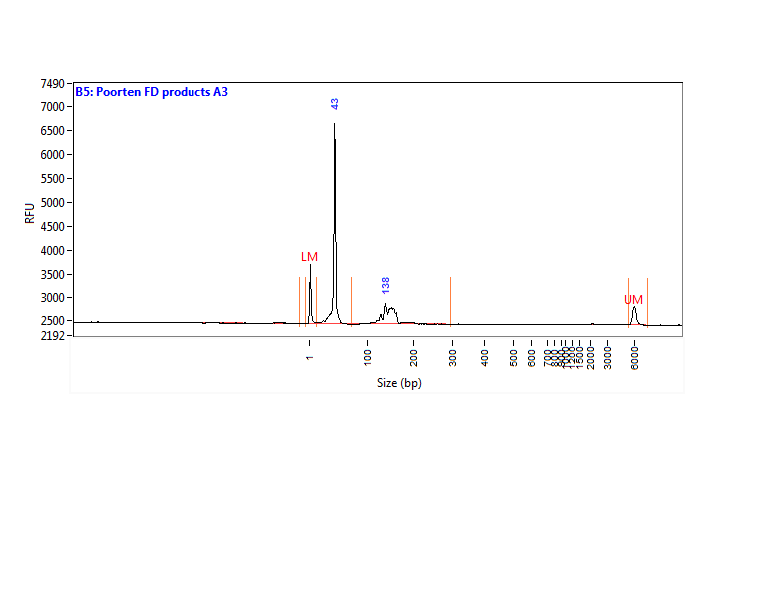
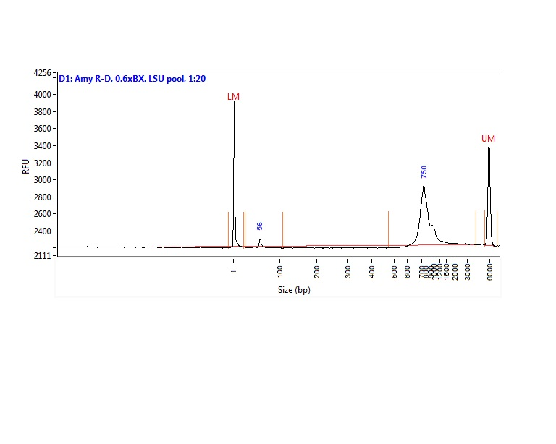
QC: what is a “good” library?
Unused primers and adapters
Unused primer
BAD!
Template of interest
Good!

Slide 90
Pooling Samples/Amplicons
Even amplicon representation is important and difficult to achieve. Amplicon counts can vary from sample to sample by 100x
Each amplicon should be evaluated by quality (ideally by trace) and quantity (fluourometery). Both qualities will effect final counts.
Best practices
First group amplicons by quality/quantity profiles
Pool each group separately
If a small number of groups consider qPCR on each group for final pooling concentrations
If a large number re-quantify and pool to final pool.

Slide 91
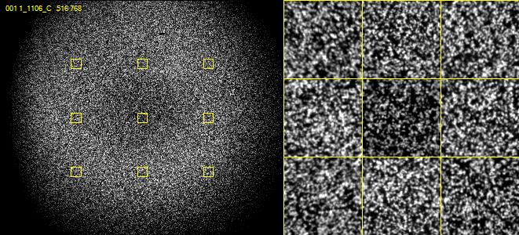
Nucleotide diversity
Critically important for imaging clusters

Slide 92
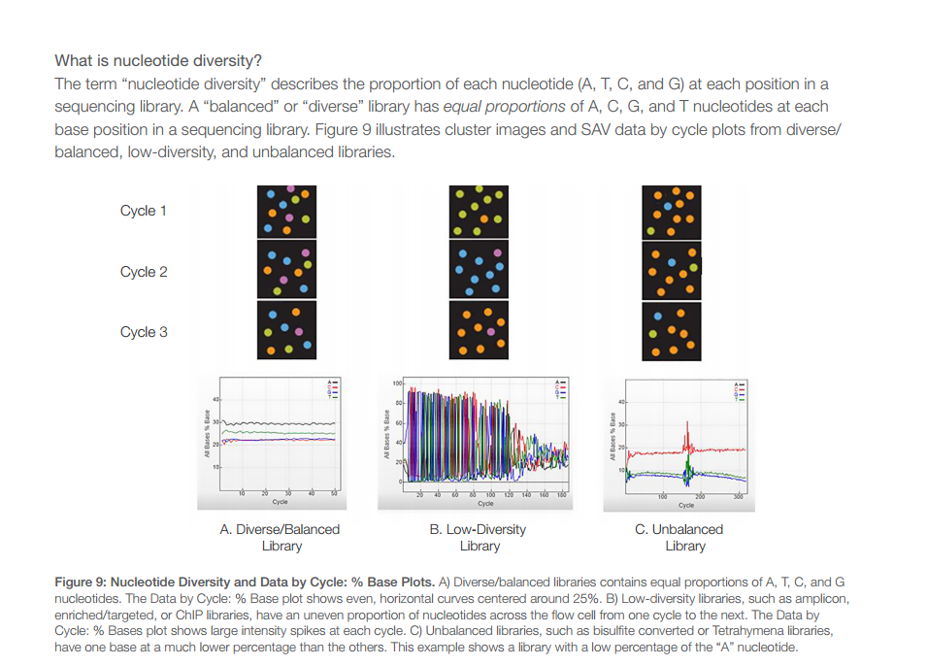
Amplicon runs are Low Complexity
Sequencing with lower cluster density
Adding in highly diverse libraries (shotgun libraries ~15%)
Phase-shifting template specific primers:

Slide 93
Benefits/Drawbacks
Benefits
Maximum Flexibility, fewer target specific primers needed.
Dual barcoding, allowing for massively multiplexing of samples to occur.
Pool multiple targets per run
Software for demultiplexing
Drawbacks
Two – step PCR reaction
Sequence the target specific primer

Slide 94
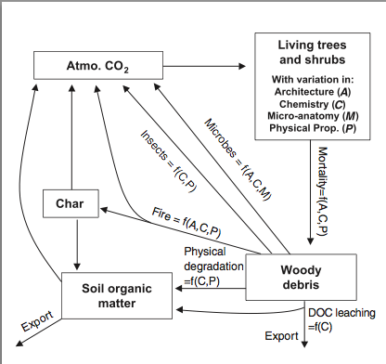
Community Profiling (Zanne Lab GWU)
Examine differences in wood decomposition rates across 21 species in two environmental settings (ridge tops and valley bottoms) and how these rates relate to plant functional traits and their fungal and microorganism communities.
576 samples X 5 amplicons
2,880 unique amplicon products
~6,000 reads per amplicon
Characterize the bacterial, fungal and ‘other’ microorganisms
(2x16S, 2xITS, and LSU)

Slide 95
Small Genome Sequencing (Top Lab UI)
1 – Fluidigm Chip
47 samples X 192 amplicons
9,024 unique amplicon products
~900 reads per amplicon
Resequencing of the pMBUI1 plasmid from three evolution experiments in E. coli, C. necator and a combination of the two (i.e. host switching) in order to identify plasmid encoded mutations that may be involved in plasmid host range expansion and evolution
Fluidigm Chip | $710
Pooling/Primers | $220
½ MiSeq run (2x300) | $1,100
Total | $2,030
 | $43/genome

Slide 96
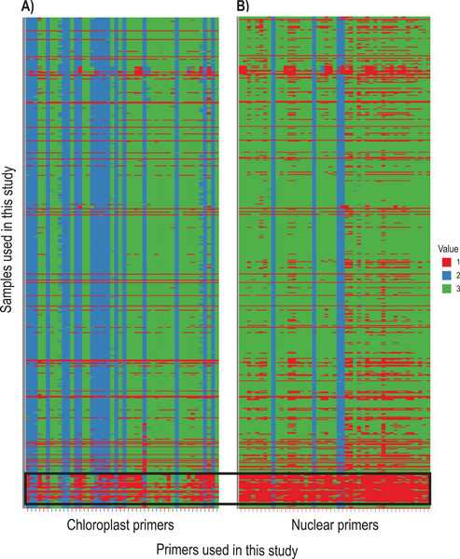
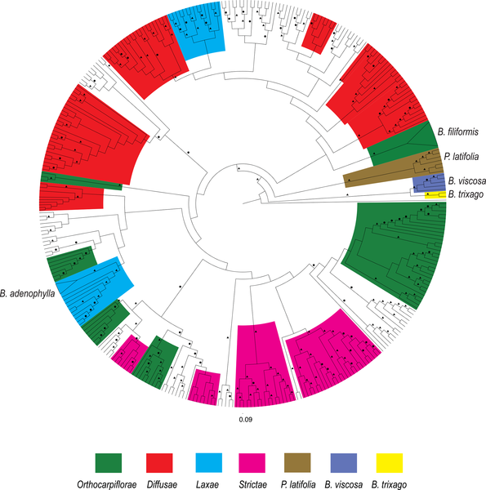
Phylogenomics (Tank Lab UI)
24 – Fluidigm Chips
576 samples X 96 amplicons
55,296 unique amplicon products
~300 reads per amplicon ~$35/sample
Sequence phylogenetically informative regions
(Chloroplast and Nuclear)
across many, many samples
Uribe-Convers S, Settles ML, Tank DC (2016) A Phylogenomic Approach Based on PCR Target Enrichment and High Throughput Sequencing: Resolving the Diversity within the South American Species of Bartsia L. (Orobanchaceae). PLoS ONE 11(2): e0148203. doi:10.1371/journal.pone.0148203
http://journals.plos.org/plosone/article?id=info:doi/10.1371/journal.pone.0148203

Slide 97
Future Directions
Include error-correcting barcodes in demultiplexing
Identification of PCR duplicates
Replace RDP classification with another scheme
Have ideas (for years) but no time
Extend to community analysis (maybe a Shiny app). dbcAmplicons is a data reduction pipeline, not a complete analysis pipeline
Incorporate the R genotyping pipeline into dbcAmplicons
Extend to inferring copy number (or ploidy levels)

Slide 98
dbcAmplicons Analysis
Approach is an DNA-result pipeline
Requires
Illumina bcl2fastq
Python
Few python libs, like biom
Flash2 (https://github.com/dstreett/FLASH2)
Bowtie2 – for off-target screening
RDP (https://github.com/rdpstaff/RDPTools) - for classification
dbcAmplicons
https://github.com/msettles/dbcAmplicons

Slide 99
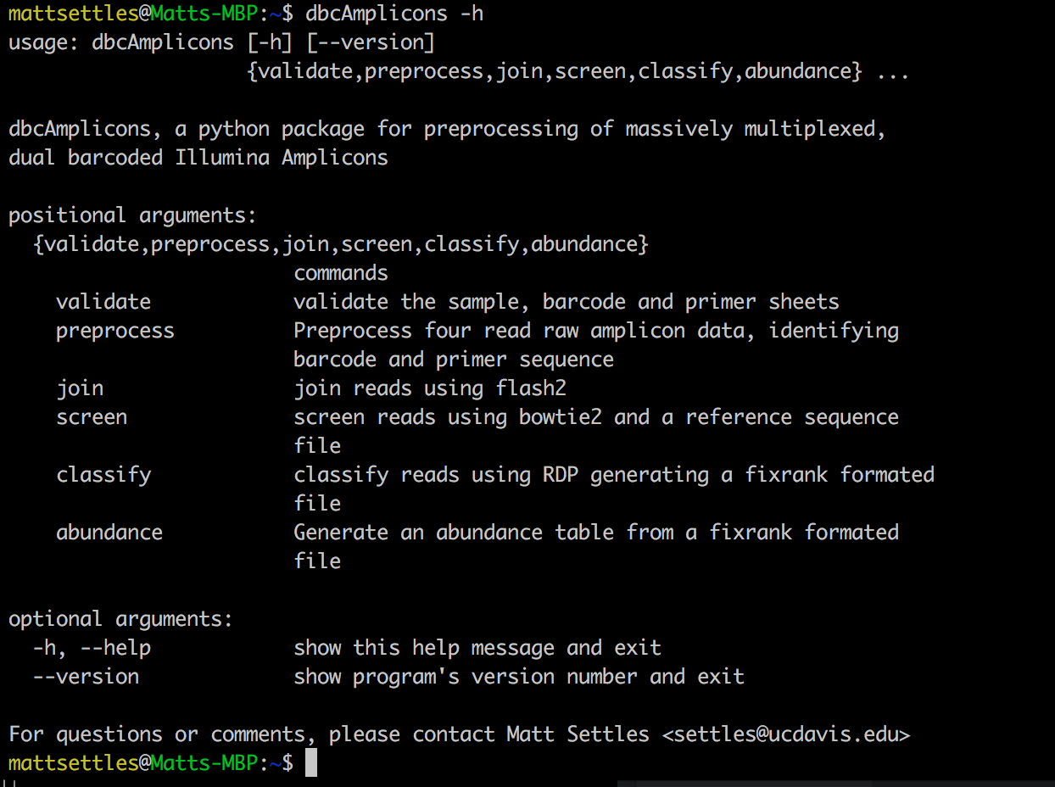
Stages of the Pipeline

Slide 100
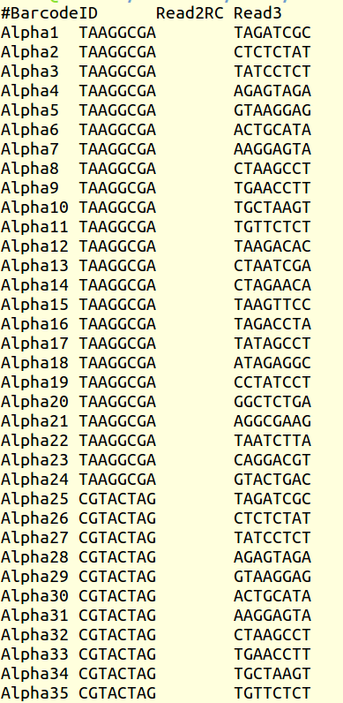
Barcodes sheet
Tab-separated text file, 3 columns
Barcode name
sequence of read 2
sequence of read 3
Orientation is important, read 2 comes off in reverse complement

Slide 101
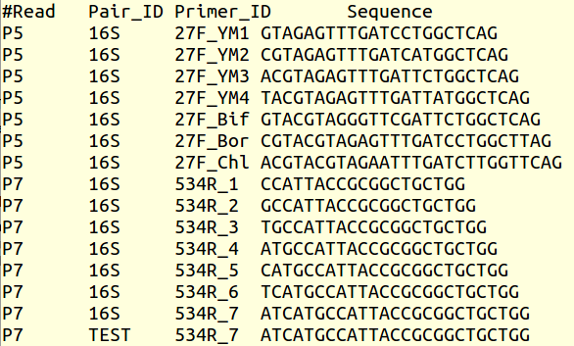
Primer sheet
Tab-separated text file, 4 columns
Read from machine
primer pair ID
individual primer ID
sequence of primer (without CS tag!)
accepts IUPAC ambiguity codes

Slide 102
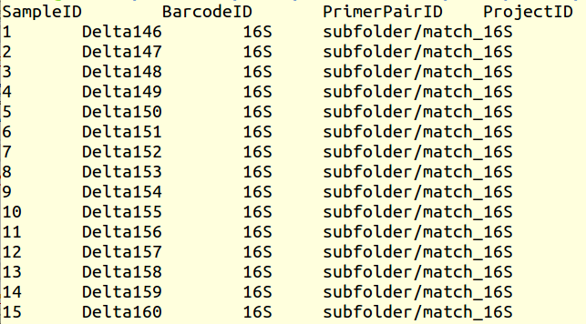
Sample metadata sheet
Tab-separated text file
4 columns required, additional metadata in additional columns will be added to biom file
Formatting is important! (no #$%^\|{}; characters)
can search multiple primers (comma separated or * [any]) or no primer (-)
can make subdirectories for individual projects

Slide 103
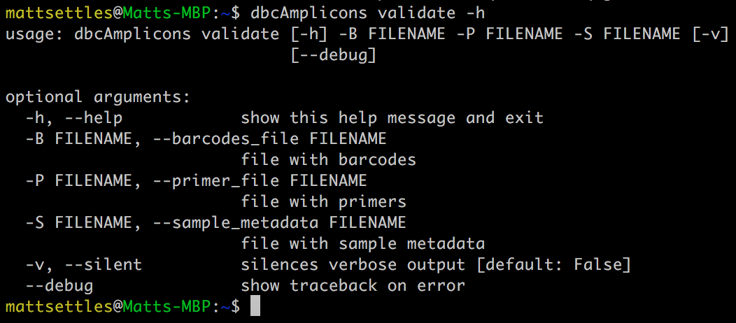
dbcAmplicons
validate command

Slide 104
Homework
Generate the
Barcode, primer and sample input files
Use dbcAmplicons validate to validate the files
Validate

Slide 105
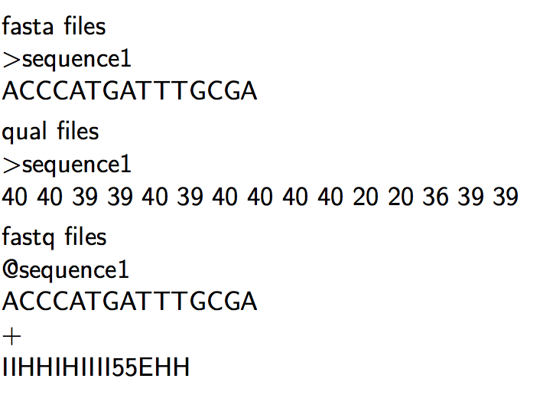
Sequencing Read files

Slide 106
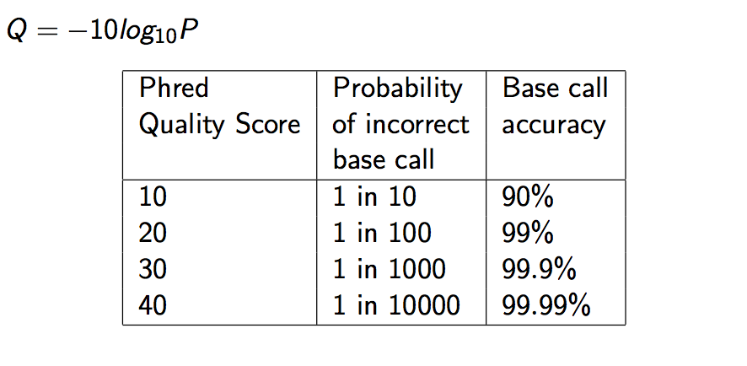
Quality Scores

Slide 107
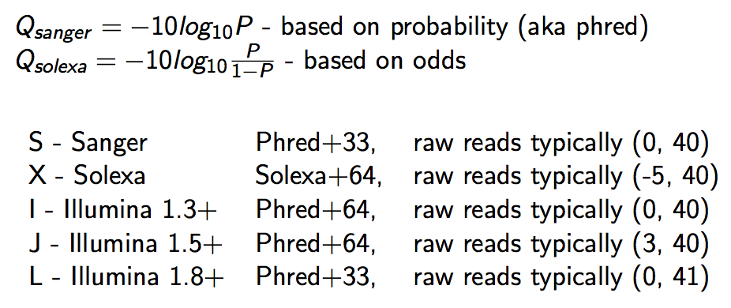
Qscore Conversion

Slide 108
Illumina Read naming conventions
CASAVA 1.8 Read IDs
@EAS139:136:FC706VJ:2:2104:15343:197393 1:Y:18:ATCACG
EAS139 the unique instrument name
136 the run id
FC706VJ the flowcell id
2 flowcell lane
2104 tile number within the flowcell lane
15343 ’x’-coordinate of the cluster within the tile
197393 ’y’-coordinate of the cluster within the tile
1 the member of a pair, 1 or 2 (paired-end or mate-pair reads only)
Y Y if the read fails filter (read is bad), N otherwise
18 0 when none of the control bits are on, otherwise it is an even number
ATCACG index sequence

Slide 109
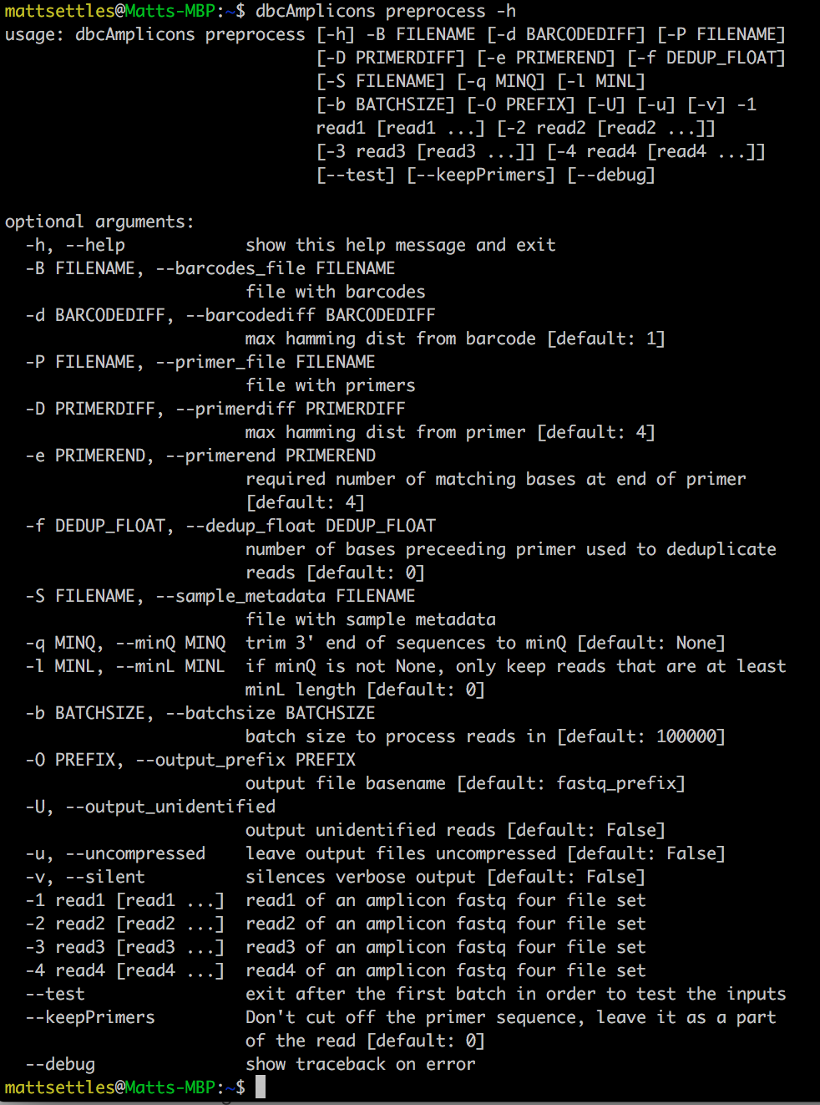
dbcAmplicons preprocess command

Slide 110
Barcode/Primer Comparison
Barcode Comparison
Primer Comparison
ACTGACTG
1
GGCTTGGTCATTTAGAGGAAGTAA
Primer 1
GTCAGCTA
6
ACTTACTG
5
TACGGCTTGGTCATTTAGAGGAAGTAA
Primer 2
TCAGTCAG
6
CGGCTTGGTCATTTAGAGGAAGTAA
Primer 3
CGTACGTA
Compares each barcode to all possible barcodes and returns the best match < desired edit distance
ACGGCTTGGTCATTTAGAGGAAGTAA
Primer 4
TACGGACTTG_TCATTTACAGGAAGTAAAAGTCGTAA
Read
Compares the beginning (primer region) of each read to all possible primers and returns the best match < specified maximimum Levenshtein disteance + final 4 exact match

Slide 111
preprocess command
The Minimal preprocess command
Takes:
4 fastq files (Read 1, Index 1, Index 2, Read 2)
Table of barcodes (indices) used in the run
Table ofsequences and names of template-specific primers
Table of sample names and the assigned barcodes and primers for each
dbcAmplicons preprocess \
-B barcodeLookupTable.txt \
-P primerLookupTable.txt \
-S sampleLookupTable.txt \
-1 data_R1_001.fastq.gz

Slide 112
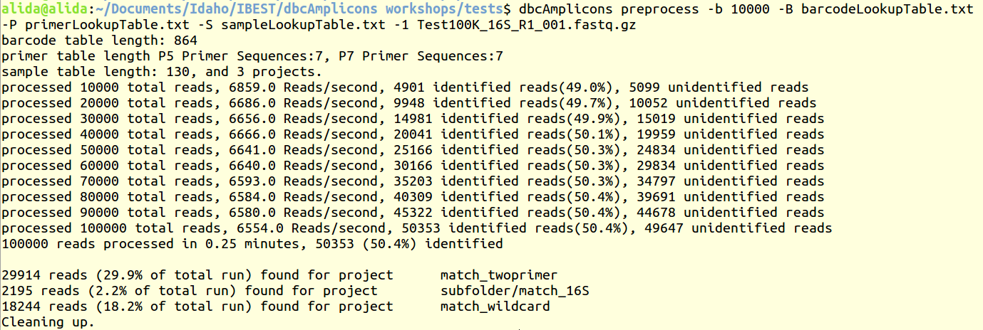
Standard Output

Slide 113
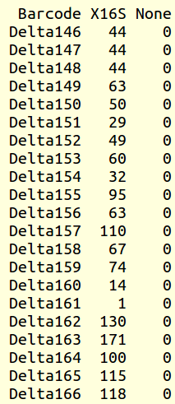
Outputs: Identified_Barcodes.txt
Tab-separated text file listing all barcodes that had at least 1 read
Rows list number of reads per barcode
Columns list the primers provided

Slide 114
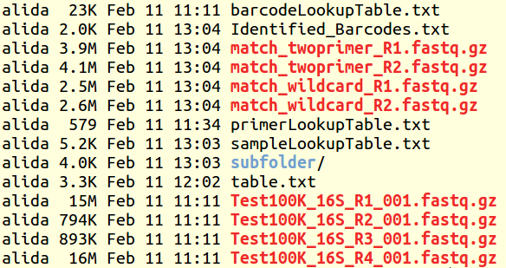
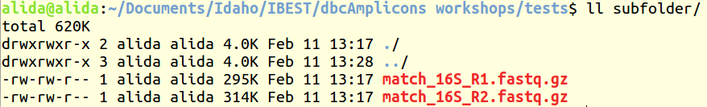
Outputs: directories and files
ProjectID column from the sample sheet determines the resulting output structure
A “folder/name” structure creates a directory with the named files within it

Slide 115
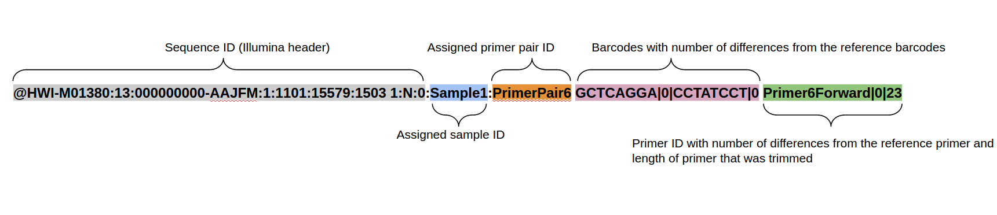
Outputs: fastq files
Header format of all identified sequences:

Slide 116
Summary of preprocess
Read 1 and Read 2 files for each unique Project_ID
Each sequence identified by barcode, primer and/or by sample name
Table of identified barcodes from the run
A number of parameters available, however defaults work most of the time

Slide 117
homework
Run
dbcAmplicons preprocess
Try --test to play with a few parameters
preprocess

Slide 118
Next: overlapping reads
dbcAmplicons join builds off of preprocess
Uses FLASH2, a modified version of flash (Fast Length Adjustment of SHort reads, http://ccb.jhu.edu/software/FLASH/) to merge paired-end reads.
Modification include:
Performs complete overlaps with adapter trimming
Allows for different sized reads (after cutting primer off)
Discards reads with > 50% Q of 2 (changed to Q10 in dbcAmplicons), which are indicative of adapter/primer dimers

Slide 119
Flash2 – overlapping of reads
Insert size
Insert size > length of the number of cycles
Read 2
Target Region
Read 1
Product: Read Pair
Insert size < length of the number of cycles (10bp min)
Insert size
Read 2
Target Region
Read 1
Product: Extended Single
Insert size < length of the read length
Insert size
Read 2
Target Region
Read 1
Product: Adapter Trimmed Single

Slide 120
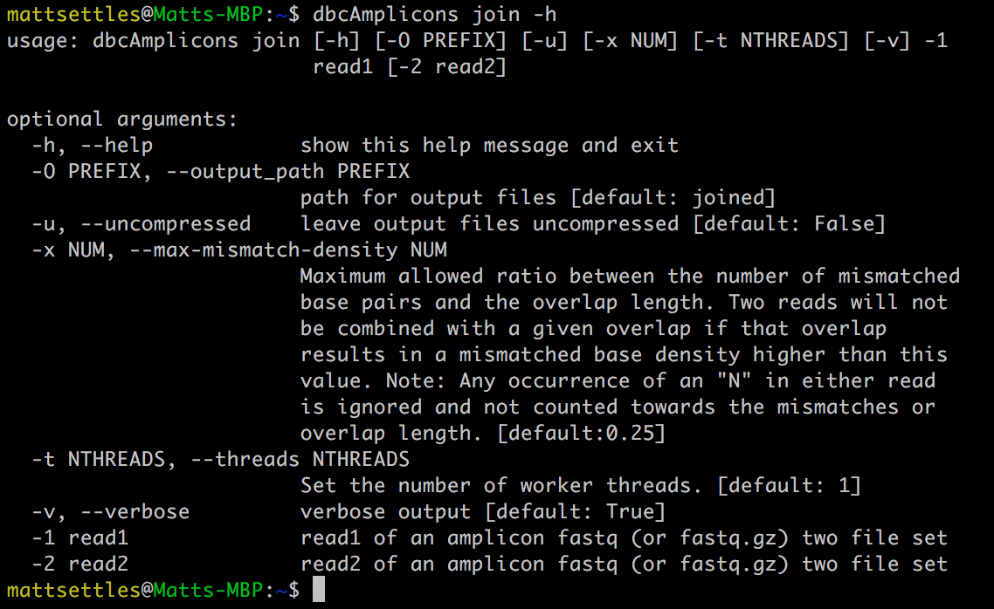
dbcAmplicons join parameters

Slide 121
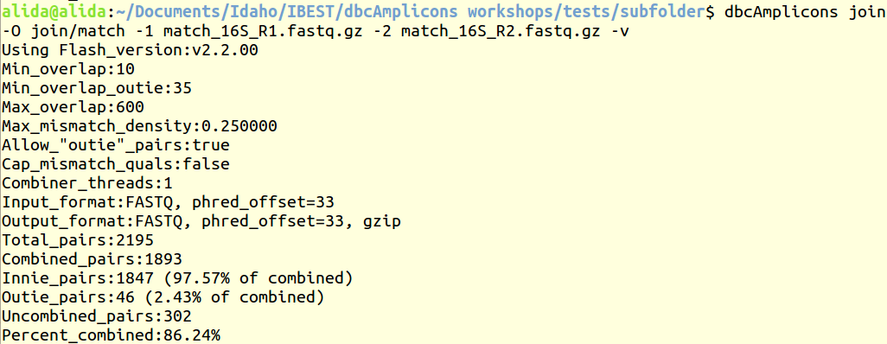
Executing dbcAmplicons join
dbcAmplicons join -O join/match -1 match_16S_R1.fastq.gz -2 match_16S_R2.fastq.gz -v

Slide 122
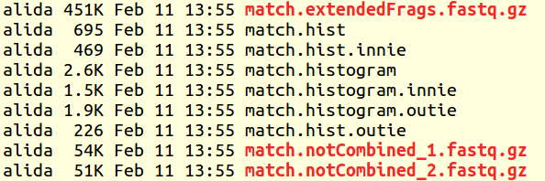
dbcAmplicons join outputs
3 fastq files: 1 of overlapped pairs [extendedFrags], 2 remaining single [notCombined_1/2] reads that didn’t overlap
Histogram showing the length of reads that overlapped and the frequency Ignore “innie” and “outie” designations for now

Slide 123
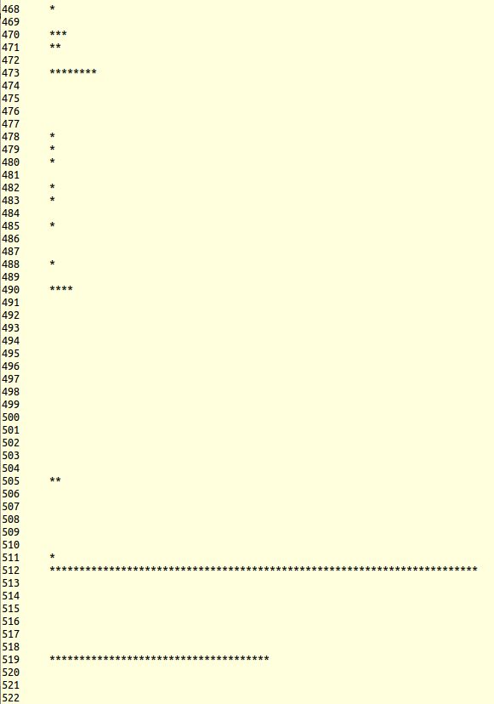
Histogram
“more match.histogram” will scroll through the file showing the lengths (symbolic)
“match.hist” gives the number of sequences that fall into each numerical category
Useful for determining the lengths of the amplicons that were sequenced

Slide 124
Homework
Using dbcAmplicons
Join the preprocessed reads
Modify the parameter
-x see how the results change
Join

Slide 125
dbcAmplicons classify
Uses the RDP (Ribosomal Database Project) classifier for bacterial and archaeal 16S, fungal LSU, ITS warcup/unite databases.
Classifies sequences to the closest taxonomic reference provides a bootstrap score for reliability
Concatenates Paired end reads

Slide 126
Direct classification vs clustering
Clustering – “Because of the increasing sizes of today’s amplicon datasets, fast and greedy de novo clustering heuristics are the preferred and only practical approach to produce OTUs”. Shared steps in these current algorithms are:
An amplicon is drawn out of the amplicon pool and becomes the center of a new OTU (centroid selection)
This centroid is then compared to all other amplicons remaining in the pool.
Amplicons for which the distance is within a global clustering threshold, t (e.g. 3%), to the centroid are moved from the pool to the OUT
The OTU is then closed. These steps are repeated as long as amplicons remain in the pool.
Problems as I see them, no biological rational to any of the clustering parameters, dependent on ordering, does not consider sequencing errors.

Slide 127
Classification

Slide 128
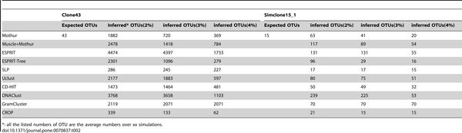

Comparing Clustering Algorithms
Chen W, Zhang CK, Cheng Y, Zhang S, Zhao H (2013) A Comparison of Methods for Clustering 16S rRNA Sequences into OTUs. PLoS ONE 8(8): e70837. doi:10.1371/journal.pone.0070837
http://journals.plos.org/plosone/article?id=info:doi/10.1371/journal.pone.0070837

Slide 129
Direct Classification
Ribosomal Database Project (RDP) - naïve Bayesian Classifier
Compares each read to a database
Database is updates periodically
Compares by k-mers (15 mers)
100 bootstraps to establish confidence in result
Order does not matter, no 3% !
Drawbacks
Accepts only fasta files
Can be slow
Down to genus only
Kmers are based on whole 16s

Slide 130
Direct classification
Read 1
Taxa 1
Read 2
Taxa 2
Read 3
Read 4
Taxa 3

Slide 131
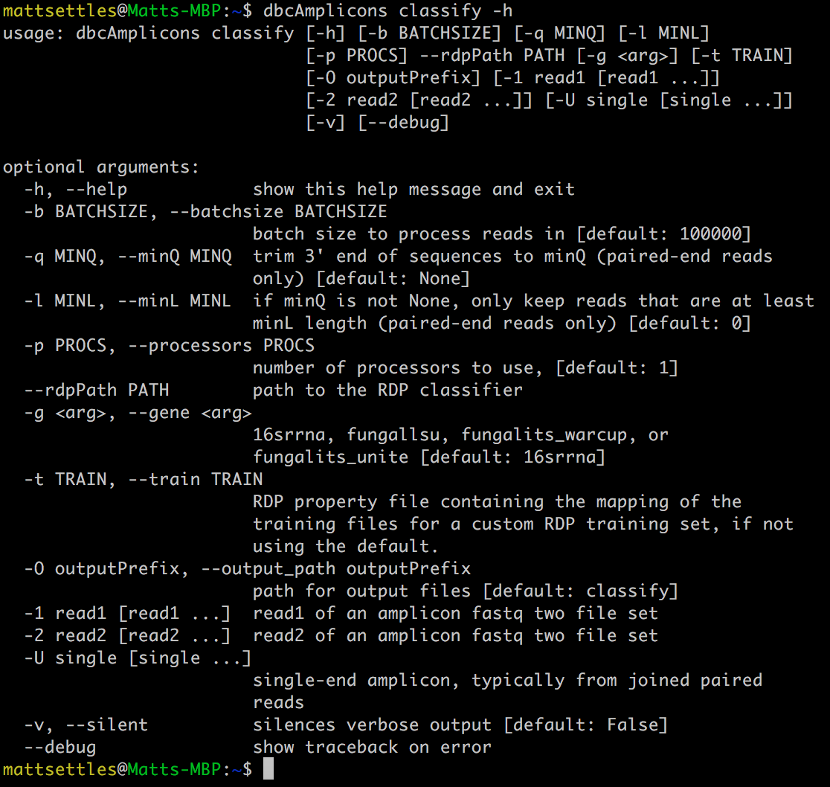
dbcAmplicons classify command

Slide 132
Using dbcAmplicons classify
dbcAmplicons classify -b 7500
-p 1
--rdpPath RDPTools/classifier.jar
-O classify/classified
-U join/match.extendedFrags.fastq.gz
-1 join/match.notCombined_1.fastq.gz
-2 join/match.notCombined_2.fastq.gz

Slide 133
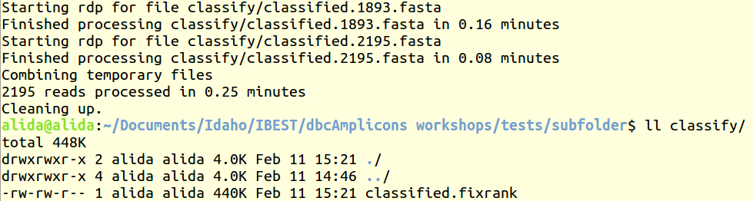
Using dbcAmplicons classify

Slide 134
fixrank files
HWI-M01380:50:000000000-A641U:1:1101:18594:1568|Sample26:16S Bacteria domain 1.0 "Actinobacteria" phylum 1.0 Actinobacteria class 1.0 Actinomycetales order 1.0 Actinomycetaceae family 1.0 Varibaculum genus 1.0
HWI-M01380:50:000000000-A641U:1:1101:17948:1574|Sample28:16S Bacteria domain 1.0 "Actinobacteria" phylum 0.96 Actinobacteria class 0.96 Bifidobacteriales order 0.9 Bifidobacteriaceae family 0.9 Aeriscardovia genus 0.23
HWI-M01380:50:000000000-A641U:1:1101:14301:1587|Sample12:16S Bacteria domain 1.0 Firmicutes phylum 0.98 Bacilli class 0.97Lactobacillales order 0.86 Lactobacillaceae family 0.81 Lactobacillus genus 0.61
HWI-M01380:50:000000000-A641U:1:1101:18207:1603|Sample19:16S Bacteria domain 1.0 Firmicutes phylum 1.0 Bacilli class 1.0 Lactobacillales order 1.0 Lactobacillaceae family 1.0 Lactobacillus genus 1.0
HWI-M01380:50:000000000-A641U:1:1101:17585:1630|Sample17:16S Bacteria domain 1.0 Firmicutes phylum 1.0 Bacilli class 1.0 Lactobacillales order 1.0 Lactobacillaceae family 1.0 Lactobacillus genus 1.0
HWI-M01380:50:000000000-A641U:1:1101:22144:1652|Sample26:16S Bacteria domain 1.0 "Actinobacteria" phylum 1.0 Actinobacteria class 1.0 Actinomycetales order 1.0 Actinomycetaceae family 1.0 Actinomyces genus 1.0

Slide 135
Homework
Classify your sequences using dbcAmplicons classify
View the fixrank file with more
Classify

Slide 136
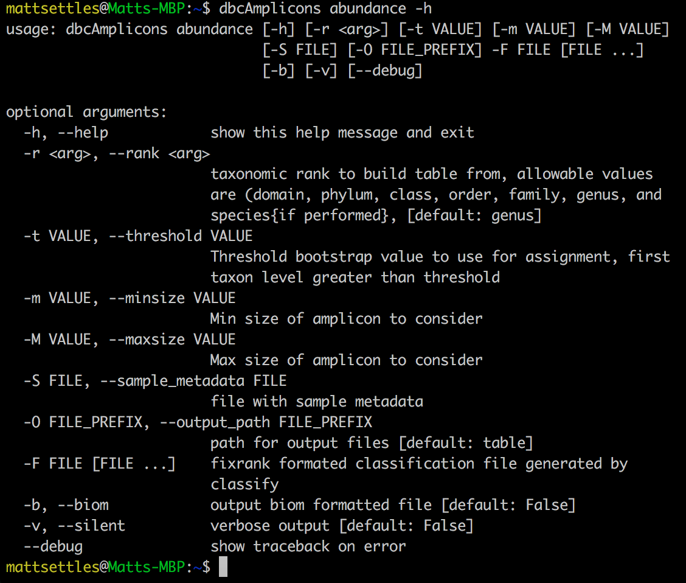
dbcAmplicons abundance

Slide 137
Generating Abundance Tables
Abundance tables
Rows are taxa
Columns are samples
Counts of the number of amplicons for each taxa/samples
Proportions tables
Same as abundance but each cell is the proportion of amplicons
Biom file (Biological Observation Matrix)
JSON file format for microbiome files
http://biom-format.org
Abundance tables are 0 heavy, a biom file removes the 0’s as well as stores extra metadata

Slide 138
dbcAmplicons abundance
dbcAmplicons abundance -F classify/classified.fixrank
Outputs 3 files:
table.abundance.txt
table.proportions.txt
table.taxa_counts.txt

Slide 139
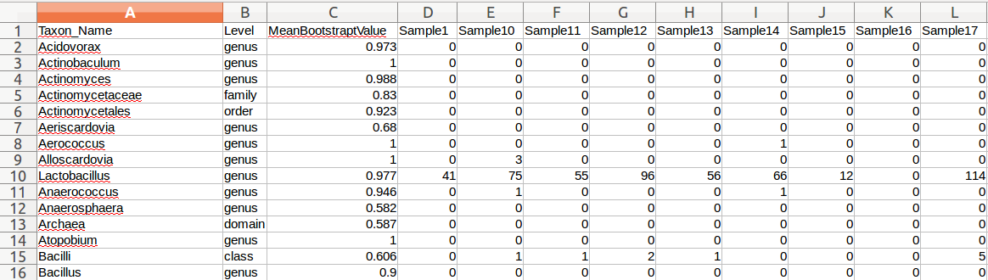
table.abundance.txt
Can open file in spreadsheet; lists lowest taxonomically classified level for each sample by read count

Slide 140

table.proportions.txt
Similar to abundance.txt, but instead lists proportions of each taxonomic level found per sample

Slide 141

table.taxa_counts.txt
Summary of each classification and the number of counts for that level across all samples

Slide 142
HOmework
Use dbcAmplicons abundance to modify abundance tables
Threshold
Rank
Generate a biom formatted file
Use the python biom package to convert the biom file to a new tab delimited file
Abundance tables

Slide 143
convert2ReadTo4Read
Back-converts a set of 2 Illumina paired-end files that have already been preprocessed by dbcAmplicons into 4 reads, splitting the 2 barcodes into separate reads.
Useful for reprocessing datasets and analyzing barcode counts.
Can be used to back covert non-dbcAmplicons reads to acceptable by dbcAmplicons

Slide 144
splitReadsBySample
(upload to SRA)
Takes processed reads from dbcAmplicons and bins each read by its sample ID. If no sample IDs are assigned, reads will be split by individual barcode.
Each sample receives a Read 1 and Read 2.
Designed for easy upload to the SRA

